Slide 1
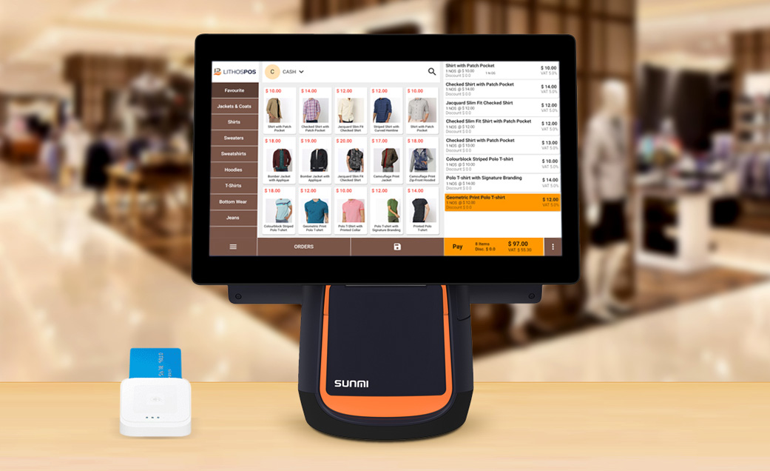
RetailDesk POS
Android-Based Point of Sale Solution

Slide 2
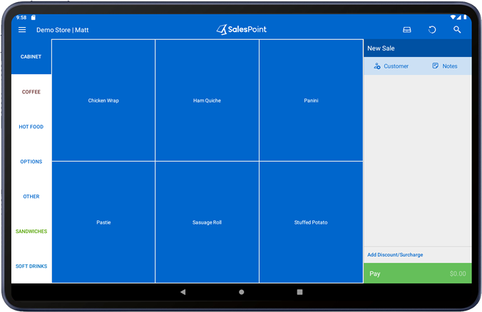





About RetailDesk POS
Innovation by Bonrix - Leading software systems provider
One-stop solution with state-of-the-art POS features
Universal compatibility with Android 2.3+ devices
Multi-device support - Kiosks, Tablets, Notebooks
Free starter version with essential features

Slide 3









Key Features
Easy Sale Point
Customer Database
Split Payments
Product entry by name, UPC, and tags with quick search
Search customers by code/name with quick add option
Flexible payment options for single transactions
Invoice Management
Barcode Receipts
Comprehensive Reports
Park, save, void, or delete individual line items
Preview invoices with barcode printing on receipts
Customer-wise sales, daily trends, category analysis
Backup & Restore
Custom Receipts
Product Categories
Secure data backup and recovery functionality
Personalized invoice and cash receipt formats
Browse products by categories and quick keys

Slide 4
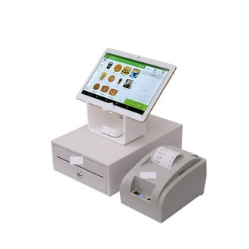



RetailDesk vs Traditional Cash Registers
Free Starter Version
No initial investment with essential features included
Works Anywhere
Compatible with all Android devices, no internet required
Easy to Customize
Scalable solution that grows with your business
Compatible Pricing
Affordable options for businesses of all sizes
Versatile Business Support
Adaptable to various retail and service industries

Slide 5








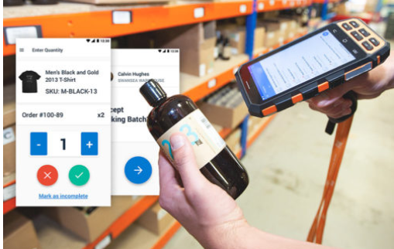
Hardware Support & Pricing
Hardware Support
Pricing Options
Receipt Printer
Barcode Scanner
Starter Version
FREE
Cash Drawer
NFC/RFID Reader
Download from Google Play with essential features
Credit Card Reader
Android Devices
Standard Version
₹7800 / $160
Free customization invoice formats with fixed supported receipt printers
Premium Version
₹12800 / $260
Customized reports and invoice formats with support for different receipt printers

Slide 6



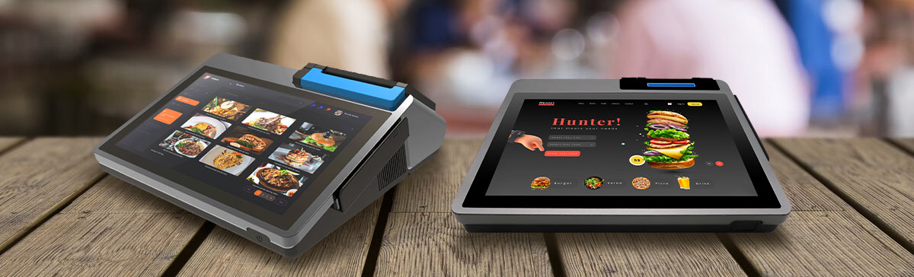






Industries We Serve
Super Markets
Retail Shops
Apparel & Footwear
Food Courts
Coffee Shops
Beauty & Salon
Furniture Stores
Dairy & Sweet
Liquor Shops

Slide 7

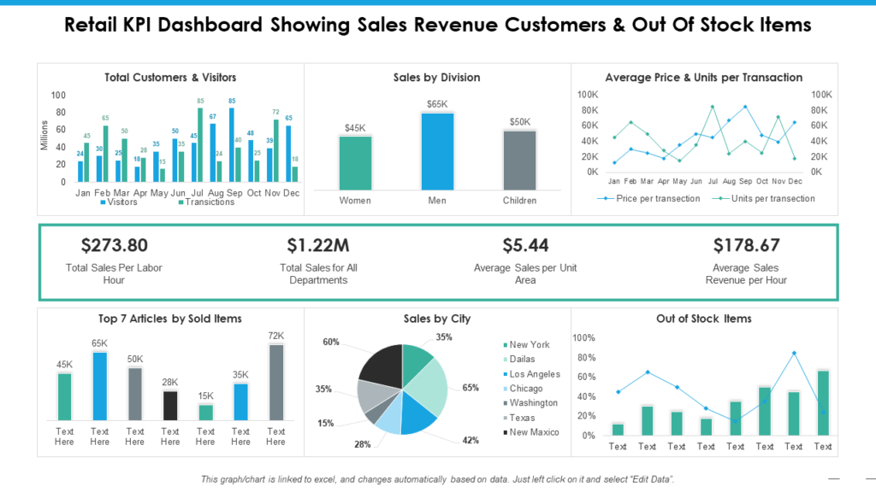



Contact Us
Website
Email
info@bonrix.net
pos.bonrix@gmail.com
Phone
+91-9426045500
Landline: +91-79-26426364
Address
A-801, Samudra Complex, Near Klassic Gold Hotel, Off C.G.Road, Ahmedabad-380009, Gujarat, India
RetailDesk POS is a product of Bonrix Software Systems

